Slide 1
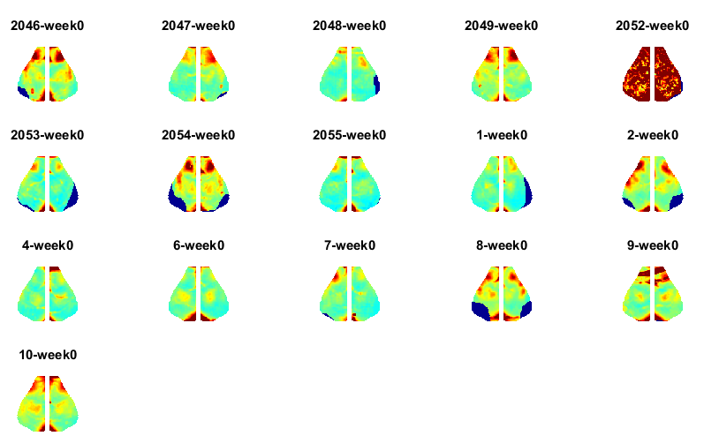
Week 0 Young Delta

Slide 2
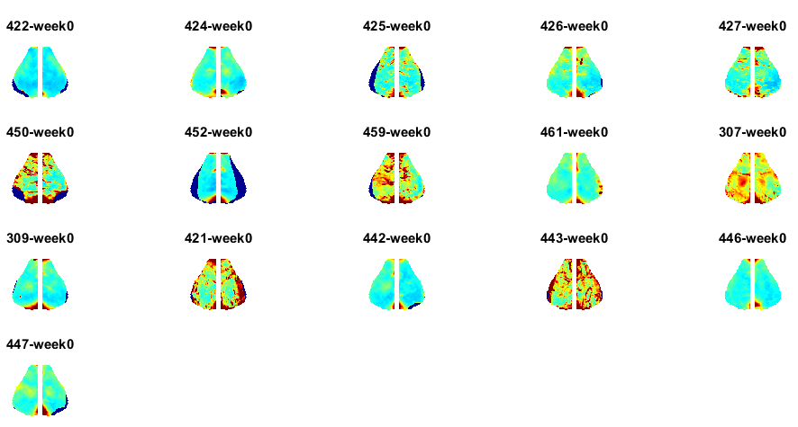

Week 0 Aged Delta
578

Slide 3
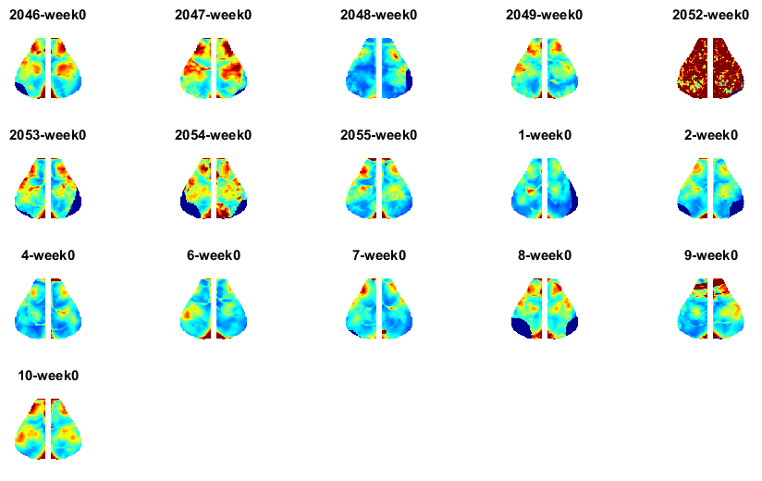
Week 0 Young Infraslow

Slide 4
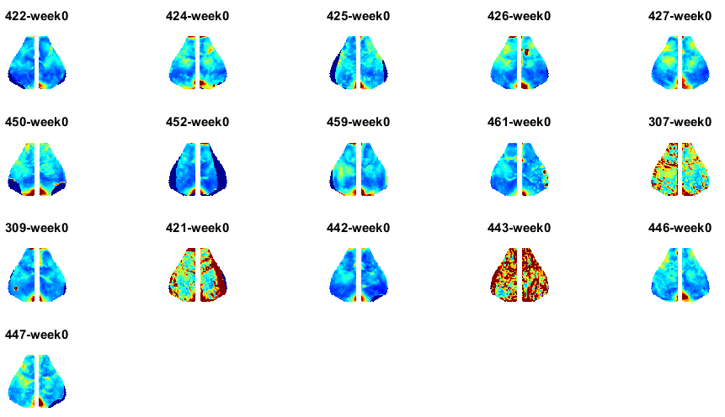

Week 0 Aged Infraslow
578

Slide 5
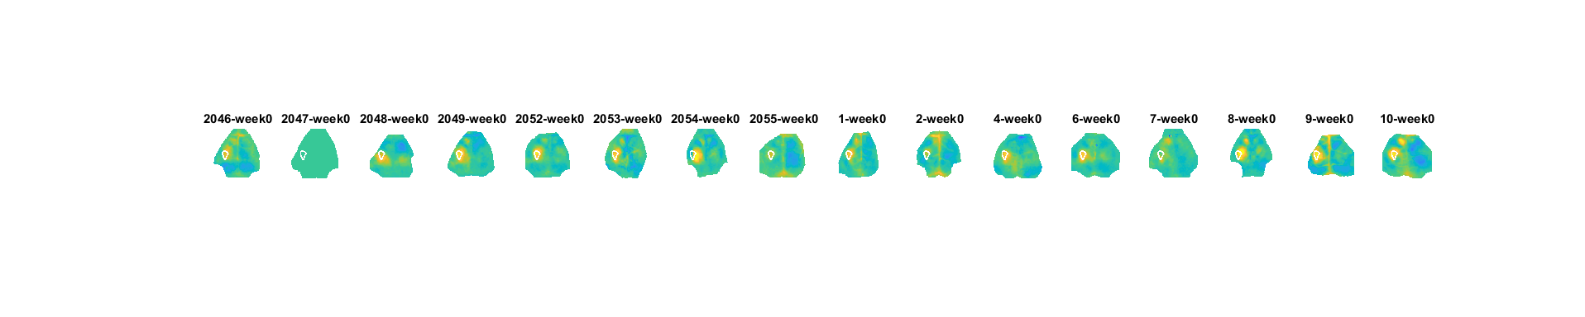
Week 0 Stim YOUNG Run 1

Slide 6
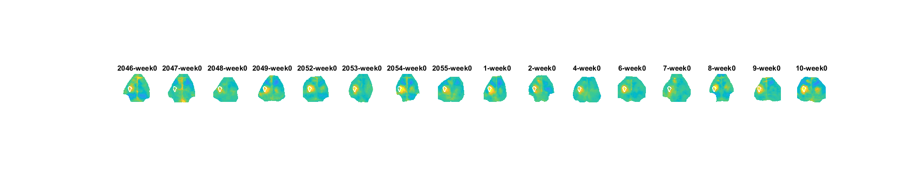
Week 0 Stim YOUNG Run 2

Slide 7
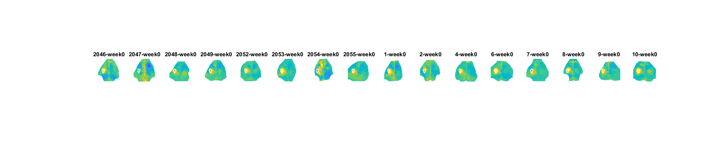
Week 0 Stim YOUNG Run 3

Slide 8
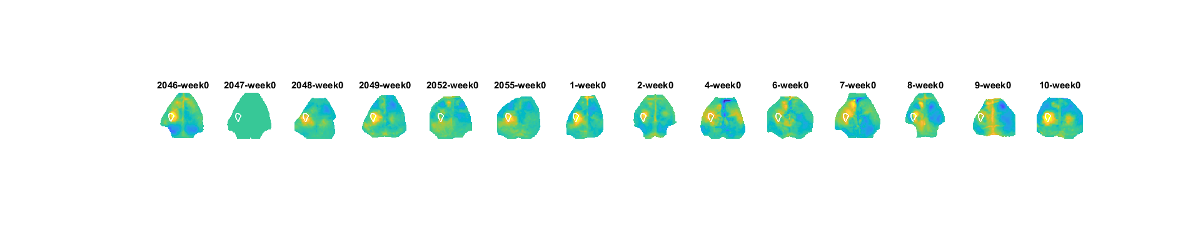
Week 0 Stim YOUNG Run 4

Slide 9
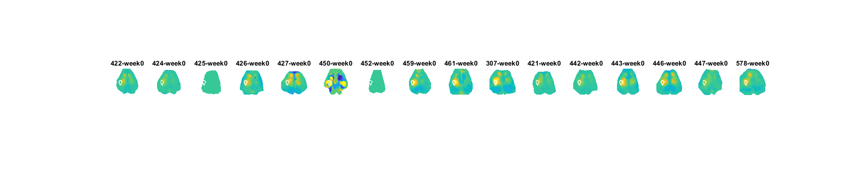

Week 0 Stim Aged Run 1

Slide 10
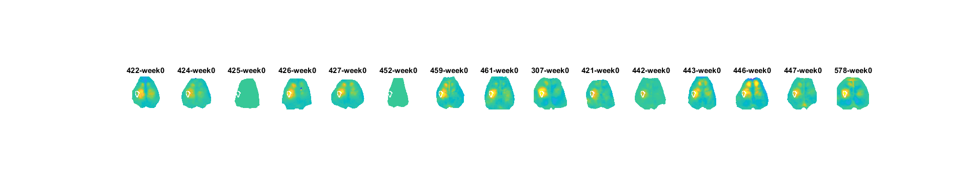

Week 0 Stim Aged Run 2

Slide 11
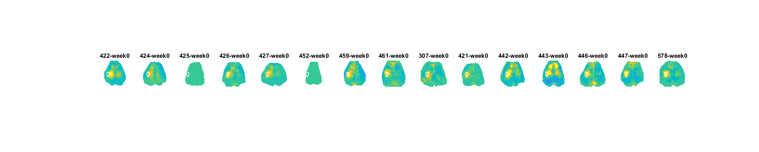
Week 0 Stim Aged Run 3

Slide 12
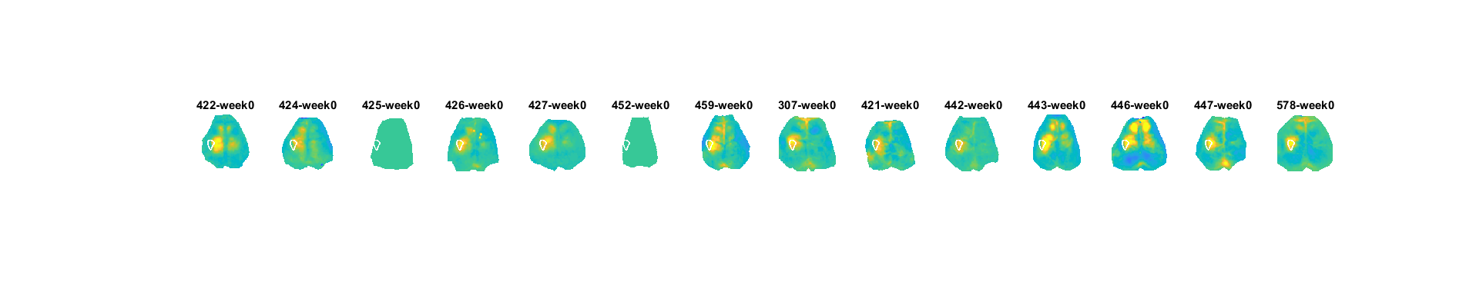

Week 0 Stim Aged Run 4

Slide 13
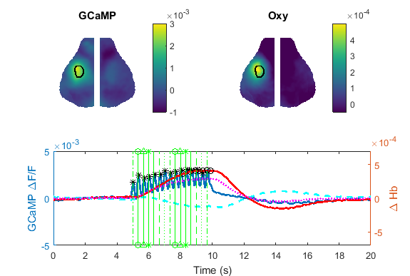
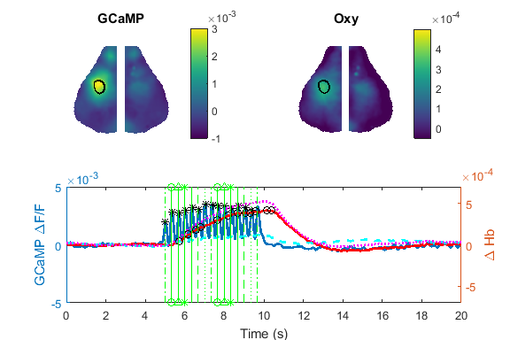
Stim Averaged Data Young and Old
Young
Aged

